Slide 1

FacePulse: Navigating Time and Attendance with Facial Recognition
Arya Patil - (22107047)
Nisha Patel - (22107037)
Prachi Pawar - (22107018)
Renuka Udugade - (22107048)
Project Guide
Prof. Poonam Pangarkar

Slide 2
Outline
Introduction
Literature Survey of the existing systems
Limitations of the existing systems
Problem statement
System Design
Technologies and methodologies
Implementation
Conclusion
References

Slide 3
Introduction
FacePulse is a software system designed to automate time and attendance tracking in schools using facial recognition technology. In essence, FacePulse aims to streamline the attendance process in schools, making it faster, more accurate, and less disruptive to the learning environment.
Motivation –
Traditional methods, like paper and ID cards, are slow and inaccurate. They disrupt class time, are prone to errors, and don't scale well for larger schools.
While advancements like barcode scanners and RFID tags exist, they require students to carry additional items and don't fully address the issues.

Slide 4
Introduction
Objectives –
Reduce the burden of manual attendance checks and paperwork, allowing teachers to dedicate more time to instruction.
Automate attendance marking for a faster and smoother process.
Eliminate errors like missed entries and buddy punching, ensuring a more reliable record of student attendance.
Handles attendance for large student bodies effortlessly, scaling up smoothly to accommodate growth without needing more staff.

Slide 5
Literature Survey of the existing system
AUTHOR | YEAR | TITLE | RESULT
Hao Yang, Xiaofeng Han | 2020 | Face Recognition Attendance System Based on Real-Time Video Processing [1] | This research demonstrates that a real-time video processing face recognition attendance system can achieve high accuracy (82%) while reducing student absenteeism. By eliminating the need for manual roll call, the system saves valuable time and improves overall efficiency in the classroom. These findings validate the concept of a face recognition attendance system and pave the way for future advancements in this technology. Further research can explore methods to improve accuracy even further and integrate the system seamlessly with existing educational management systems.

Slide 6
Literature Survey of the existing system
AUTHOR | YEAR | TITLE | RESULT
Jacqueline G. Cavazos, P. Jonathon Phillips, Carlos D. Castillo, Alice J. O’Toole | 2021 | Accuracy Comparison Across Face Recognition Algorithms: Where Are We on Measuring Race Bias? [2] | We observed that race bias exists in face recognition algorithms, influenced by both data factors (image quality, population statistics) and how the algorithm is used (decision thresholds, user demographics). Dataset difficulty and identification thresholds significantly impacted the level of bias, with some algorithms requiring higher thresholds for accurate identification of non-Caucasian faces. These findings highlight the need for careful evaluation and mitigation strategies to ensure fair and unbiased performance of face recognition algorithms across diverse populations.

Slide 7
Literature Survey of the existing system
AUTHOR | YEAR | TITLE | RESULT
Shreyak Sawhney, Karan Kacker, Samyak Jain | 2019 | Real Time Smart Attendance System using Face Recognition Techniques [3] | Being a prime feature of biometric verification, facial recognition is being used enormously in several such applications, like video monitoring and CCTV footage system, an interaction between computer & humans and access systems present indoors and network security. By utilizing this framework, the problem of proxies and students being marked present even though they are not physically present can easily be solved.

Slide 8
Limitations of existing systems
Facial recognition technology offers a powerful tool for various applications, but it's not without its limitations. Here's a breakdown of some current limitations across various facial recognition apps.
Accuracy: Lighting, occlusions, and database quality can impact accuracy.
Security & Privacy: Data collection, storage, security breaches, and potential misuse raise concerns.
Usability & Integration: User interfaces, scalability, and integration challenges exist.
Cost, Bias, and Functionality also pose limitations.

Slide 9
Problem statement
The aim of this project is to develop an advanced facial attendance system that overcomes the limitations of existing systems, providing high accuracy, speed, usability, integration capabilities, and security.
Key areas for improvement-
Enhanced accuracy and security: Minimize errors and prevent buddy punching.
Privacy and transparency: Implement clear data collection practices and user control.
Usability and scalability: User-friendly interface for efficient operation.
Seamless integration: Integrate seamlessly with existing school systems.

Slide 10
System Design
LOGIN PAGE
HOME PAGE
Add / View Student Details and Upload Sample Photos
View / Manage the Uploaded Sample Student Photos
EXIT
Update And Store The Attendance Status
Compare and Identify Captured Faces Against the Trained Database
Train the Uploaded Sample Photos

Slide 11
Technologies and methodologies
Front End-
Python using tkinter (VSCode)
Back End-
MySQL 8.0
Microsoft Excel

Slide 12
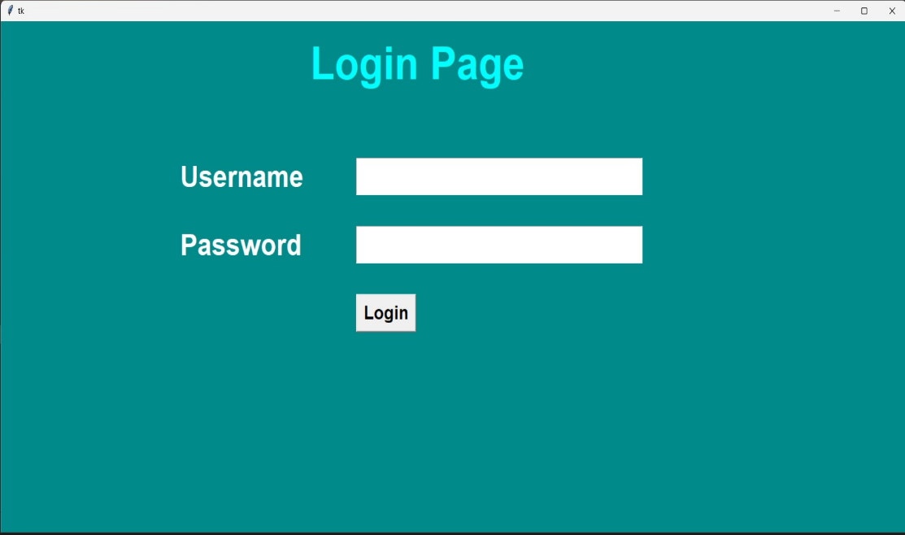
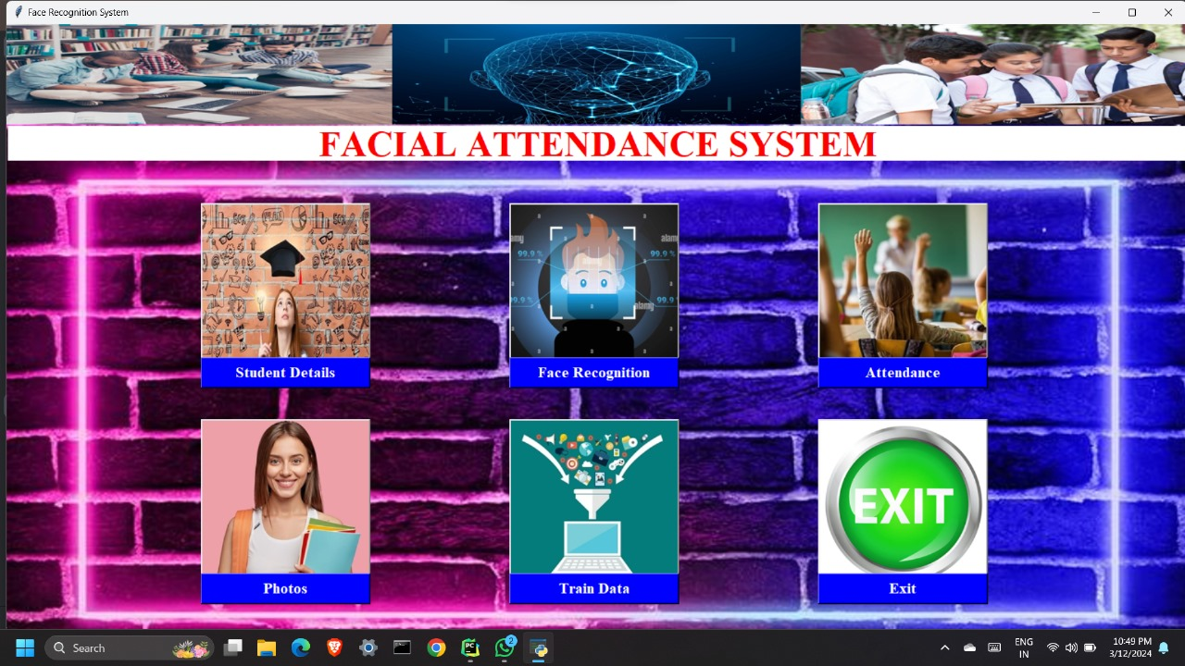
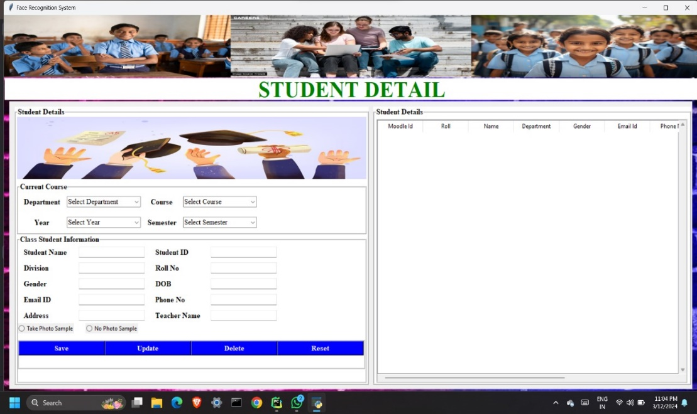
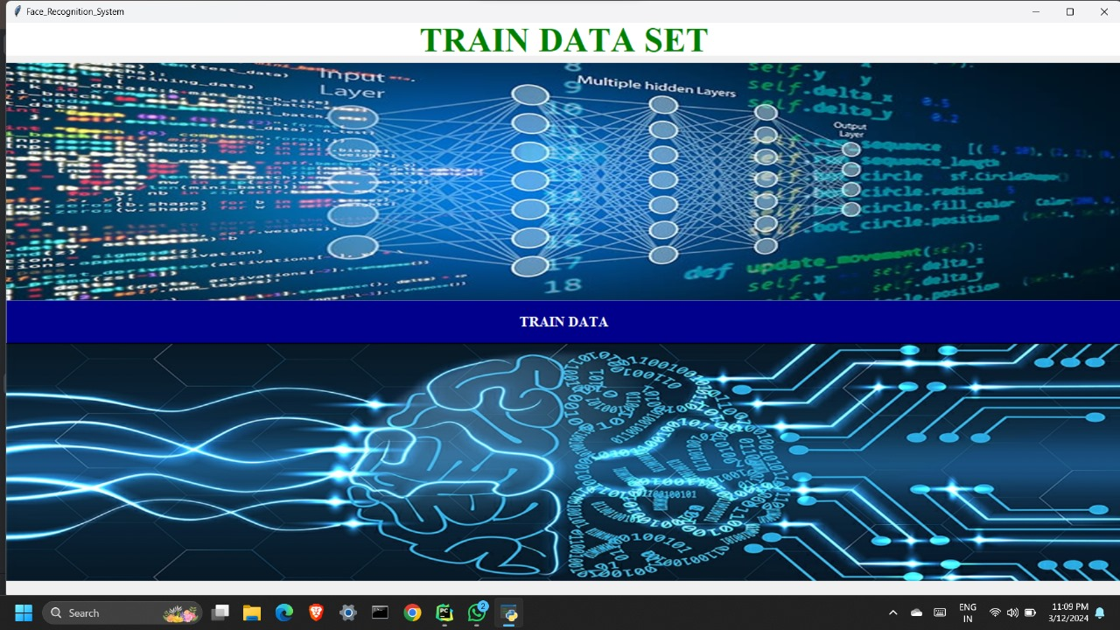
Implementation

Slide 13
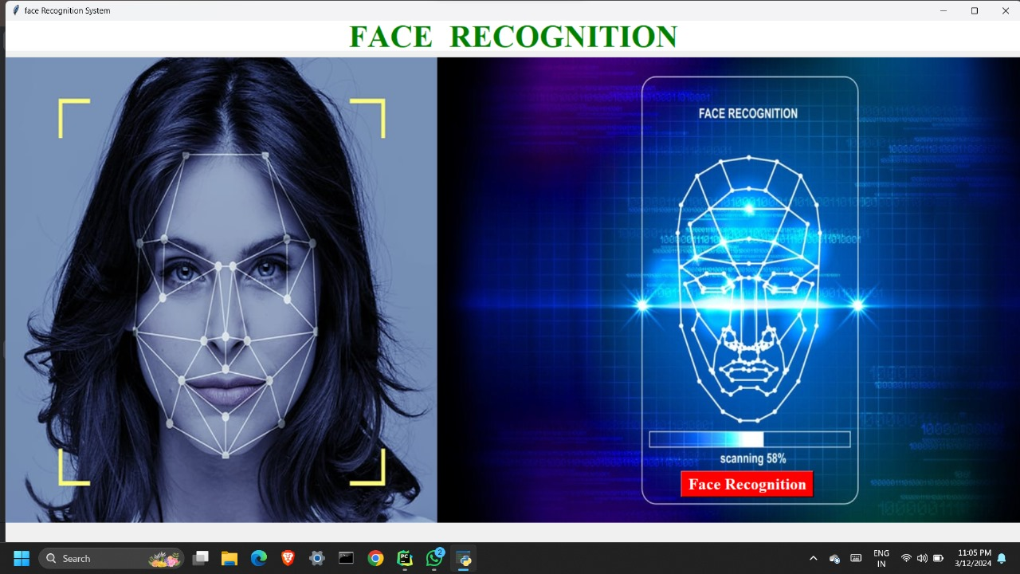
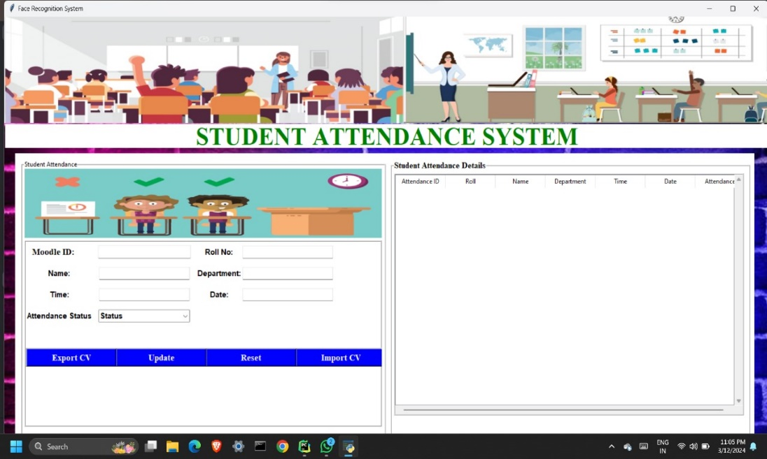
Implementation

Slide 14
Conclusion
FacePulse represents a significant step towards a more efficient and secure future of attendance tracking. It is a facial recognition system designed to revolutionize attendance management. We've focused on the user experience, showcasing the intuitive GUIs that will streamline the attendance process for both students and administrators.

Slide 15
References
[1] Hao Yang, Xiaofeng Han (2020) “Face Recognition Attendance System Based on Real-Time Video Processing”, IEEE Access, Volume 8
[2] Jacqueline G. Cavazos, P. Jonathon Phillips, Carlos D. Castillo, Alice J. O’Toole (2021) “Accuracy Comparison Across Face Recognition Algorithms: Where Are We on Measuring Race Bias?”, IEEE Transactions on Biometrics, Behaviour, and Identity Science, Volume 3
[3] Shreyak Sawhney, Karan Kacker, Samyak Jain (2019) “Real Time Smart Attendance System using Face Recognition Techniques”, International Conference on Cloud Computing, Data Science and Engineering, IEEE

Slide 16
Thank You...!!

